Slide 1
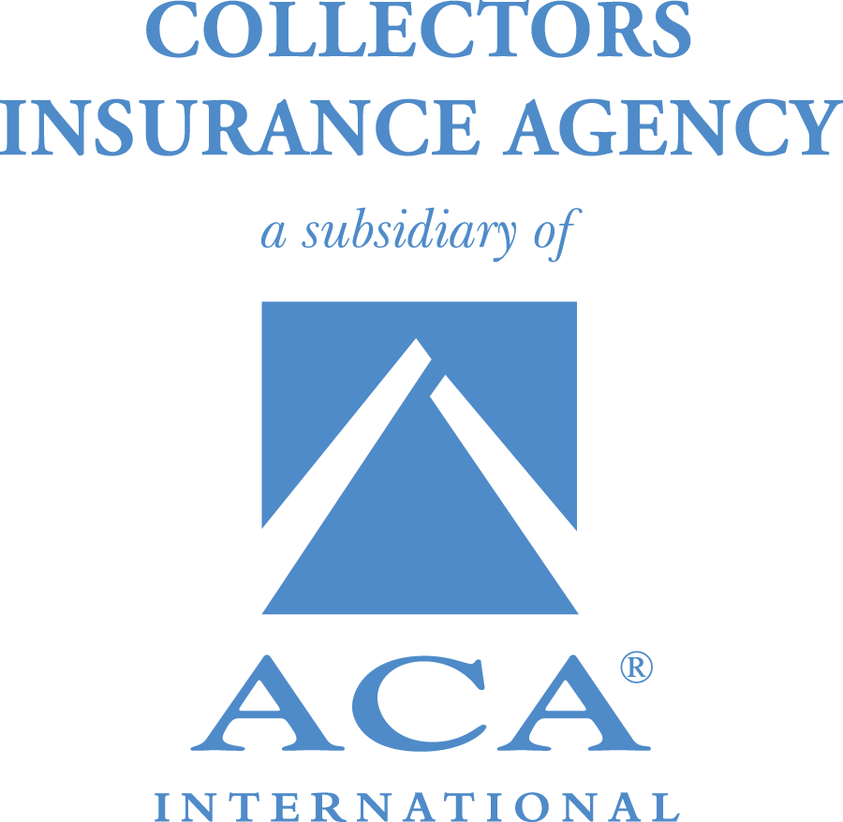
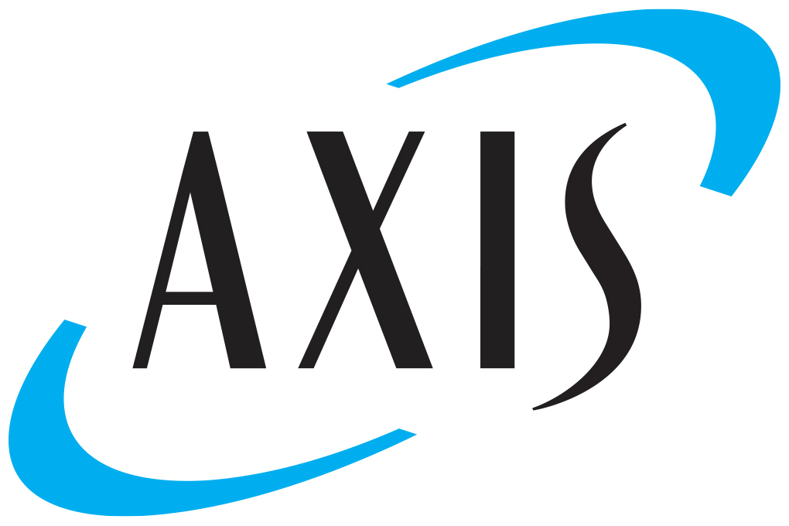
Collectors Insurance Agency, Inc. Cyber Insurance

Slide 2
Who is CIA?
Collectors Insurance Agency, Inc. (CIA) is a wholly owned subsidiary of ACA International.
CIA is a nationally licensed insurance agency providing commercial insurance, surety bonds and licensing services tailored to the accounts receivables management industry.

Slide 3
Who is Aon?
Aon Risk Services, the largest insurance broker globally, offers dedicated expert resources to provide CIA with program management services and access to the insurance markets. Aon’s daily interaction with CIA and its carriers brings ACA members vast coverage options.

Slide 4
Who is Axis?
Axis is an A-rated carrier (A.M. Best) providing insurance and reinsurance. Axis specializes in cyber insurance tailored to fit all business sizes. Access to the ACTM (Axis Cyber Technology & MPL) Policy for the ARM industry is exclusive through CIA.

Slide 5
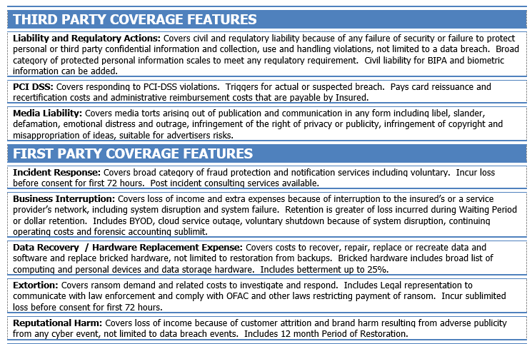
Policy Coverage Details
Note 1: Limits offered range between $250k and $5M (depending on revenues)
Note 2: Need additional coverages including higher limits? CIA can help!
Note 3: Social engineering coverage is offered through CIA’s QBE Crime policy.

Slide 6
Thanks!
For more information, contact CIA:
www.acainternational.org
collectorsinsurance@acainternational.org
(952) 928-8000, #4

